Slide 1
Computer Graphics
2D transformations

Slide 2
Overview
Why transformations?
Basic transformations:
  translation, rotation, scaling
Combining transformations
  homogenous coordinates, transform. Matrices
First 2D, next 3D

Slide 3
Transformations
instantiation…
world
train
animation…
viewing…
wheel
modelling…
image

Slide 4
Why transformation?
Model of objects
  world coordinates: km, mm, etc.
  Hierarchical models::
  human = torso + arm + arm + head + leg + leg
  arm = upperarm + lowerarm + hand …
Viewing
  zoom in, move drawing, etc.
Animation

Slide 5
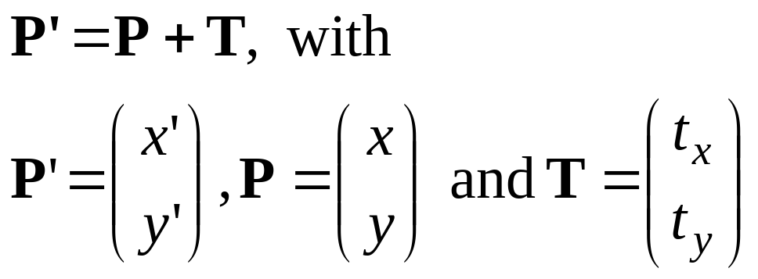
Translation
Translate over vector (t_{x}, t_{y})
x’=x+ t_{x}, y’=y+ t_{y}
or
y
P+T
T
P
x

Slide 6
Translation polygon
Translate polygon:
Apply the same operation on all points.
Works always, for all transformations of objects defined as a set of points.
y
T
x

Slide 7
2-D Rotation
(x’, y’)
(x, y)
x’ = x cos(θ) - y sin(θ)
y’ = x sin(θ) + y cos(θ)
θ

Slide 8
2-D Rotation
x = r cos (φ)
y = r sin (φ)
x’ = r cos (φ + θ)
y’ = r sin (φ + θ)
Trig Identity…
x’ = r cos(φ) cos(θ) – r sin(φ) sin(θ)
y’ = r cos(φ) sin(θ) + r sin(φ) cos(θ)
Substitute…
x’ = x cos(θ) - y sin(θ)
y’ = x sin(θ) + y cos(θ)
(x’, y’)
(x, y)
θ
φ

Slide 9
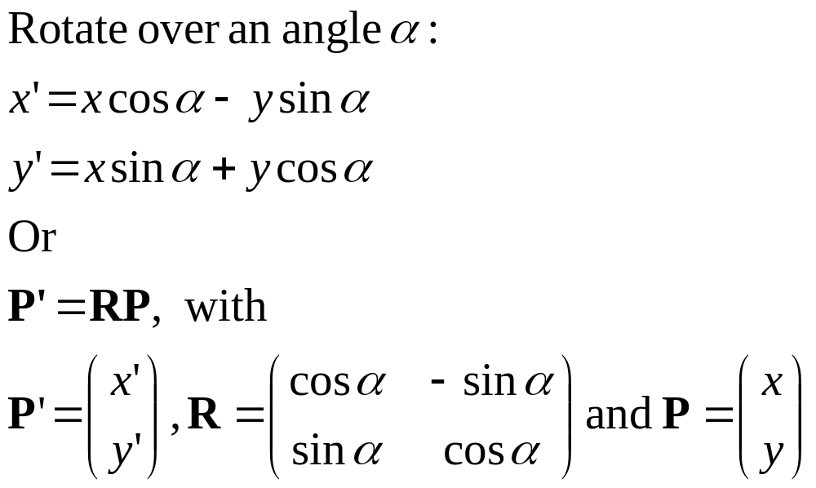
Rotation
y
y
P’
α
P
x
x

Slide 10
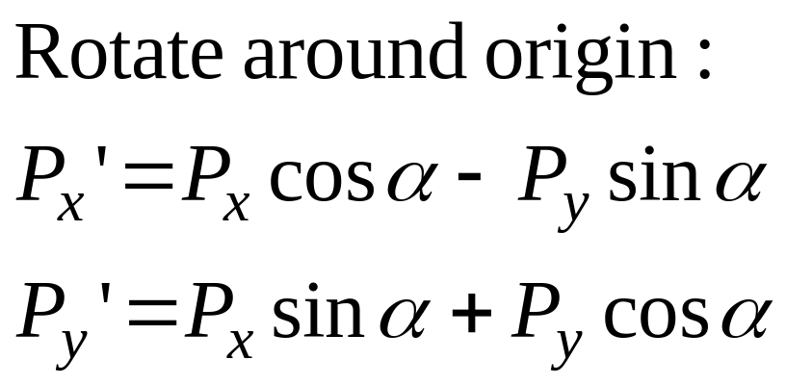
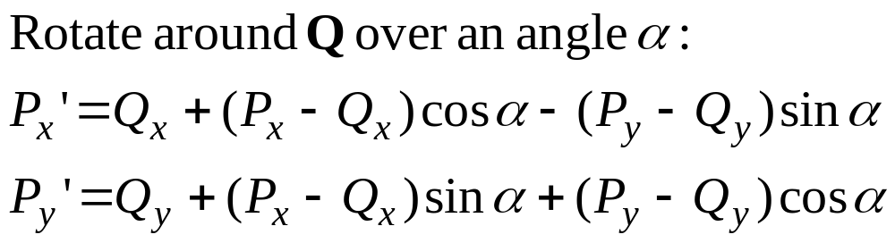
Rotation around a point Q
y
y
P’
α
P
P−Q
Q
x
x

Slide 11
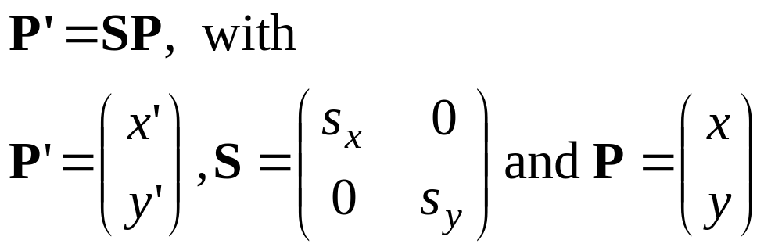
Scaling
Schale with factor s_{x} and s_{y}:
x’= s_{x} x, y’= s_{y} y
or
y
P’
P
Q’
Q
x
x

Slide 12
Scaling with respect to a point F
y
Scale with factors s_{x} and s_{y}:
P_{x}’= s_{x} P_{x}, P_{y}’= s_{y}P_{y}
With respect to F:
P_{x}’ − F_{x} = s_{x} (P_{x} − F_{x}),
P_{y}’ − F_{y} = s_{y} (P_{y} − F_{y})
or
P_{x}’= F_{x} + s_{x} (P_{x} − F_{x}),
P_{y}’= F_{y} + s_{y} (P_{y} − F_{y})
P’
P
P−F
Q’
F
Q
x
x

Slide 13
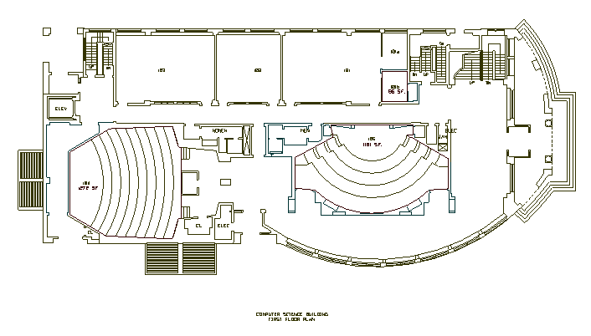
2D Modeling Transformations
Modeling
Coordinates
Scale
Translate
y
x
Scale
Rotate
Translate
World Coordinates

Slide 14
2D Modeling Transformations
Modeling
Coordinates
y
x
Let’s look
at this in
detail…
World Coordinates

Slide 15
2D Modeling Transformations
Modeling
Coordinates
y
x
Initial location
at (0, 0) with
x- and y-axes
aligned

Slide 16
2D Modeling Transformations
Modeling
Coordinates
y
x
Scale .3, .3
Rotate -90
Translate 5, 3

Slide 17
2D Modeling Transformations
Modeling
Coordinates
y
x
Scale .3, .3
Rotate -90
Translate 5, 3

Slide 18
2D Modeling Transformations
Modeling
Coordinates
y
x
Scale .3, .3
Rotate -90
Translate 5, 3
World Coordinates

Slide 19
Basic 2D Transformations
Translation:
  x’ = x + t_{x}
  y’ = y + t_{y}
Scale:
  x’ = x * s_{x}
  y’ = y * s_{y}
Rotation:
  x’ = x*cosΘ - y*sinΘ
  y’ = x*sinΘ + y*cosΘ
Transformations
can be combined
(with simple algebra)

Slide 20
Basic 2D Transformations
Translation:
  x’ = x + t_{x}
  y’ = y + t_{y}
Scale:
  x’ = x * s_{x}
  y’ = y * s_{y}
Rotation:
  x’ = x*cosΘ - y*sinΘ
  y’ = x*sinΘ + y*cosΘ

Slide 21
Basic 2D Transformations
Translation:
  x’ = x + t_{x}
  y’ = y + t_{y}
Scale:
  x’ = x * s_{x}
  y’ = y * s_{y}
Rotation:
  x’ = x*cosΘ - y*sinΘ
  y’ = x*sinΘ + y*cosΘ
(x,y)
(x’,y’)
x’ = x*s_{x}
y’ = y*s_{y}

Slide 22
Basic 2D Transformations
Translation:
  x’ = x + t_{x}
  y’ = y + t_{y}
Scale:
  x’ = x * s_{x}
  y’ = y * s_{y}
Rotation:
  x’ = x*cosΘ - y*sinΘ
  y’ = x*sinΘ + y*cosΘ
(x’,y’)
x’ = (x*s_{x})*cosΘ - (y*s_{y})*sinΘ
y’ = (x*s_{x})*sinΘ + (y*s_{y})*cosΘ

Slide 23
Basic 2D Transformations
Translation:
  x’ = x + t_{x}
  y’ = y + t_{y}
Scale:
  x’ = x * s_{x}
  y’ = y * s_{y}
Rotation:
  x’ = x*cosΘ - y*sinΘ
  y’ = x*sinΘ + y*cosΘ
(x’,y’)
x’ = ((x*s_{x})*cosΘ - (y*s_{y})*sinΘ) + t_{x}
y’ = ((x*s_{x})*sinΘ + (y*s_{y})*cosΘ) + t_{y}

Slide 24
Basic 2D Transformations
Translation:
  x’ = x + t_{x}
  y’ = y + t_{y}
Scale:
  x’ = x * s_{x}
  y’ = y * s_{y}
Rotation:
  x’ = x*cosΘ - y*sinΘ
  y’ = x*sinΘ + y*cosΘ
x’ = ((x*s_{x})*cosΘ - (y*s_{y})*sinΘ) + t_{x}
y’ = ((x*s_{x})*sinΘ + (y*s_{y})*cosΘ) + t_{y}

Slide 25
Transformations
Translate with V:
  T = P + V
Schale with factor s_{x} = s_{y} =s:
  S = sP
Rotate over angle α:
  R’_{x} = cos α P_{x} − sin α P_{y}
  R’_{y} = sin α P_{x} + cos α P_{y}
y
S
R
T
P
x

Slide 26
Transformations…
Messy!
Transformations with respect to points: even more messy!
How to combine transformations?

Slide 27
Homogeneous coordinates 1
Uniform representation of translation, rotation, scaling
Uniform representation of points and vectors
Compact representation of sequence of transformations

Slide 28
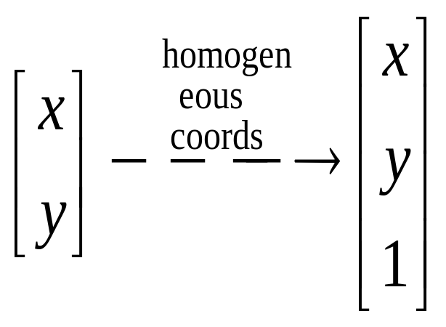
Homogeneous Coordinates
Homogeneous coordinates
  represent coordinates in 2 dimensions with a 3-vector
Homogeneous coordinates seem unintuitive, but they make graphics operations much easier

Slide 29
Homogeneous coordinates 2
Add extra coordinate:
P = (p_{x} , p_{y} , p_{h}) or
x = (x, y, h)
Cartesian coordinates: divide by h
x = (x/h, y/h)
Points: h = 1 (for the time being…),
vectors: h = 0

Slide 30
Homogeneous Coordinates
Add a 3rd coordinate to every 2D point
  (x, y, w) represents a point at location (x/w, y/w)
  (x, y, 0) represents a point at infinity
  (0, 0, 0) is not allowed
y
2
(2,1,1)
or (4,2,2)
or (6,3,3)
1
Convenient coordinate system to
represent many useful transformations
x
1
2

Slide 31
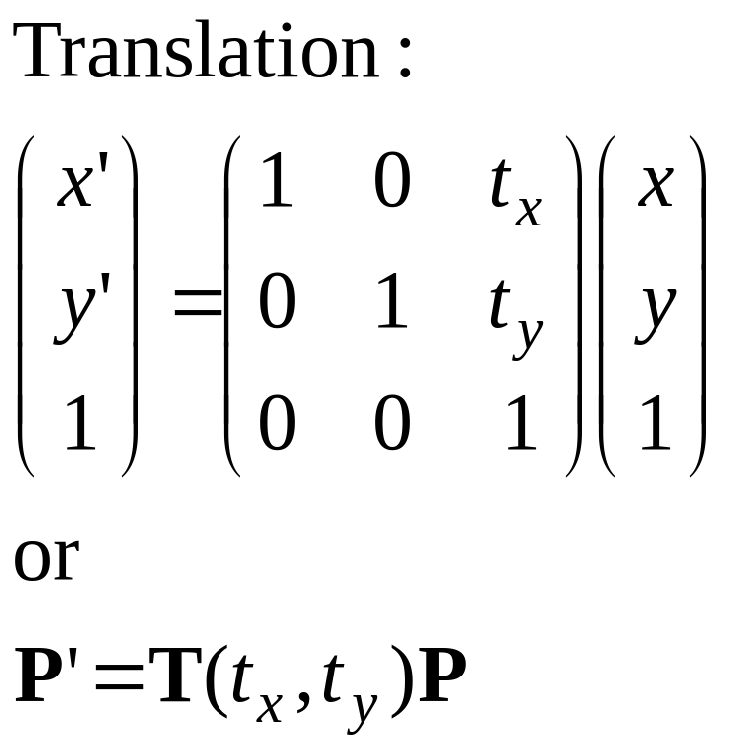
Translation matrix

Slide 32
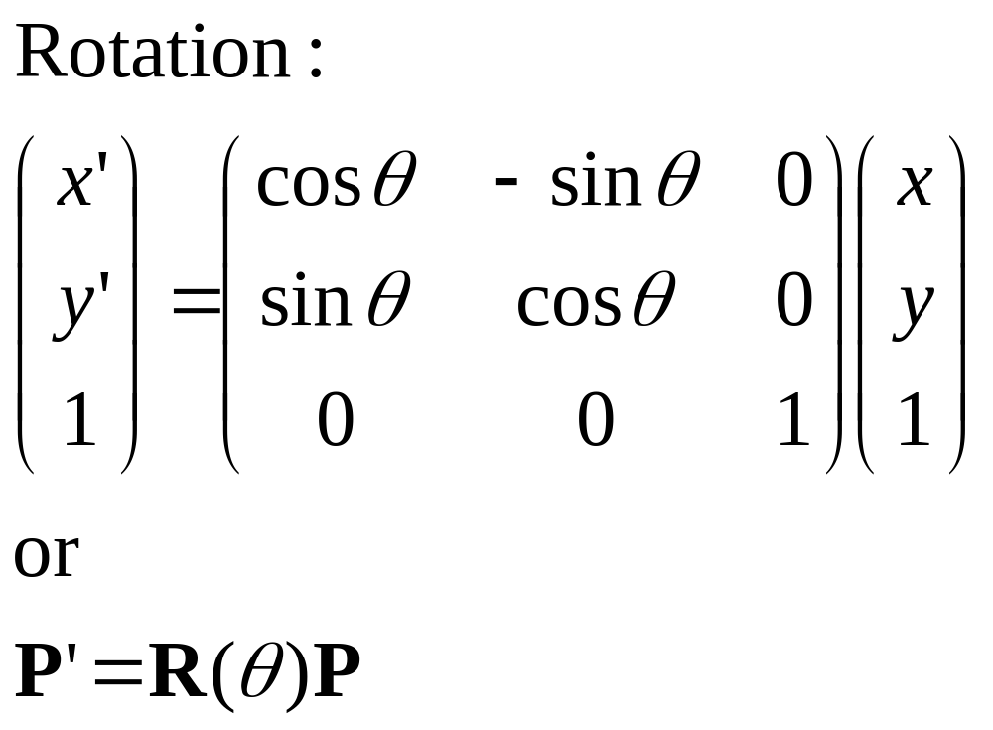
Rotation matrix

Slide 33
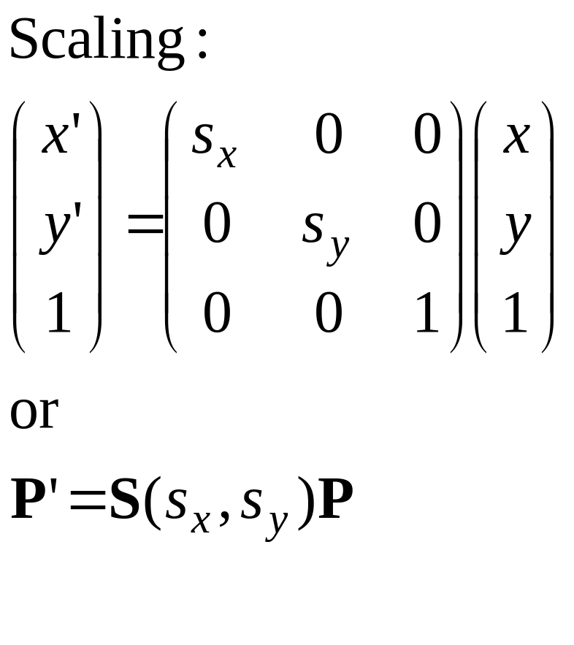
Scaling matrix

Slide 34
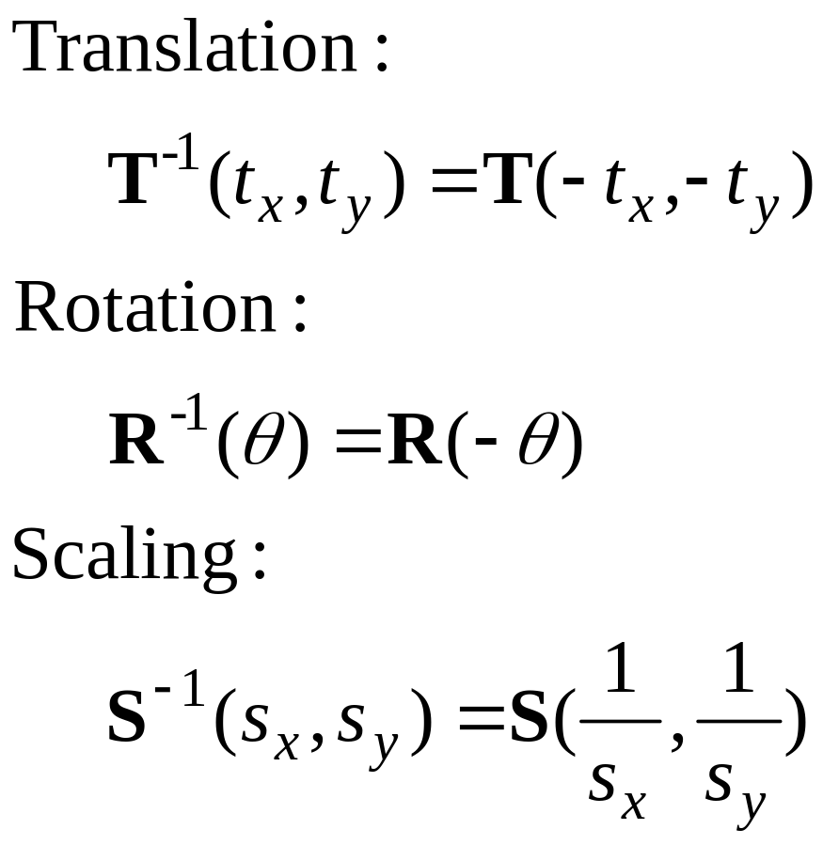
Inverse transformations

Slide 35
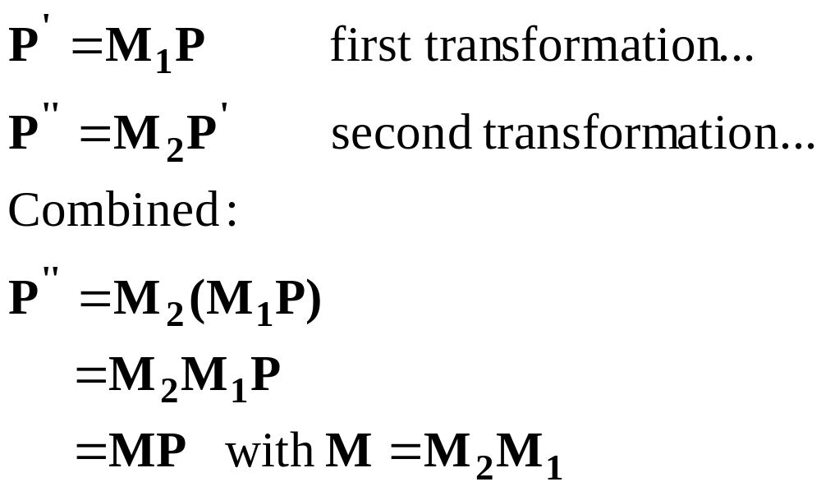
Combining transformations 1

Slide 36
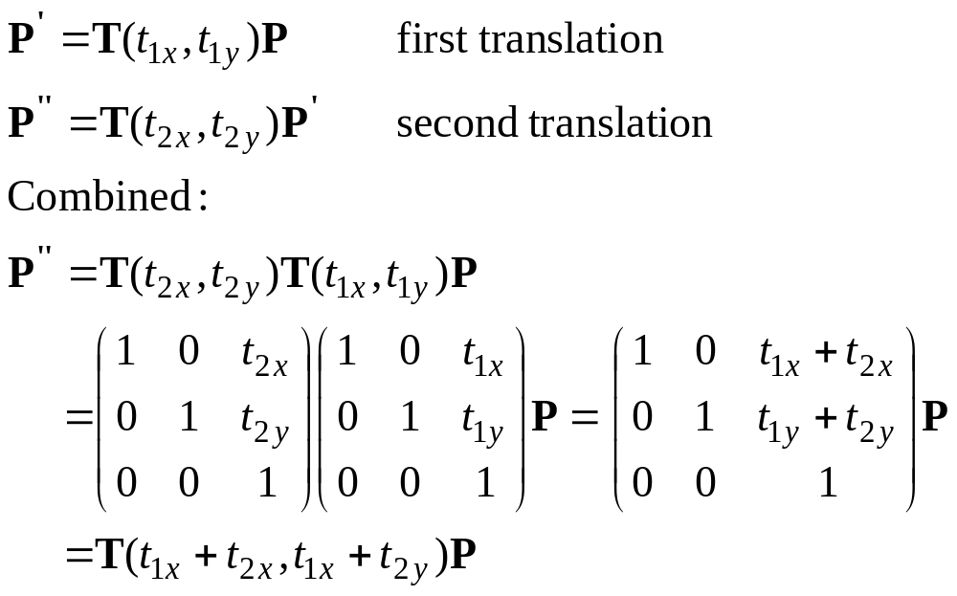
Combining transformations 2

Slide 37
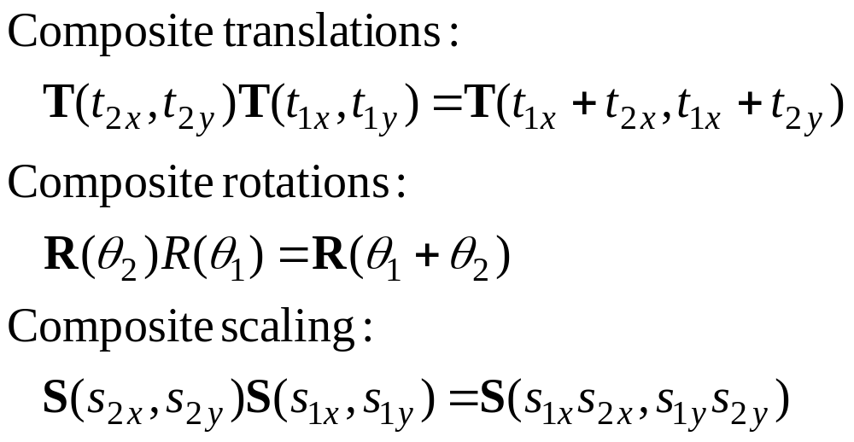
Combining transformations 3

Slide 38
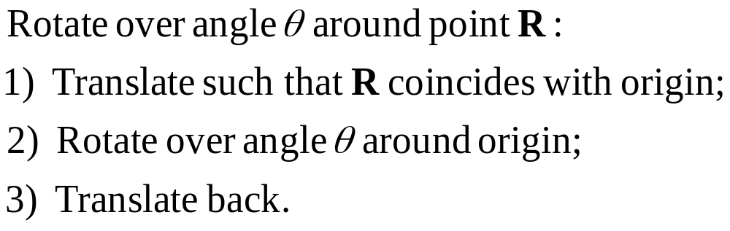
Rotation around a point 1
R
1) 2) 3)

Slide 39
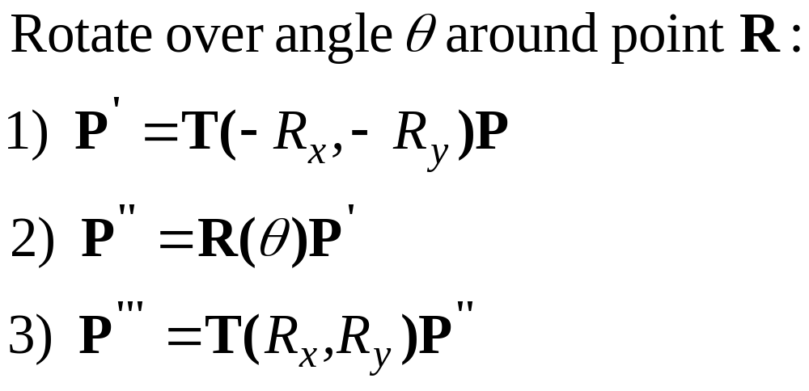
Rotation around a point 2
R
1) 2) 3)

Slide 40
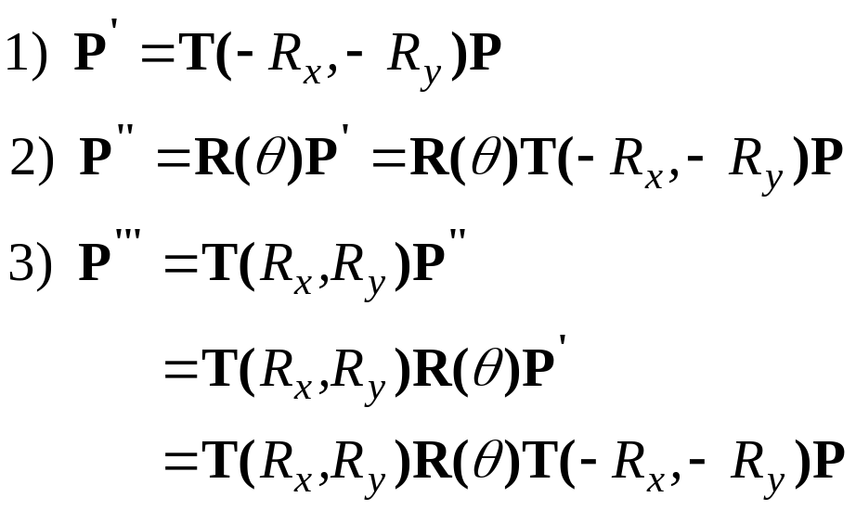
Rotation around point 3
R
1) 2) 3)

Slide 41
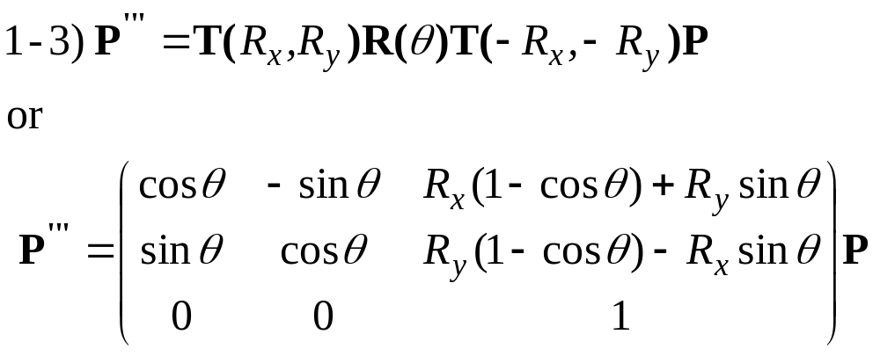
Rotation around point 4
R
1) 2) 3)

Slide 42
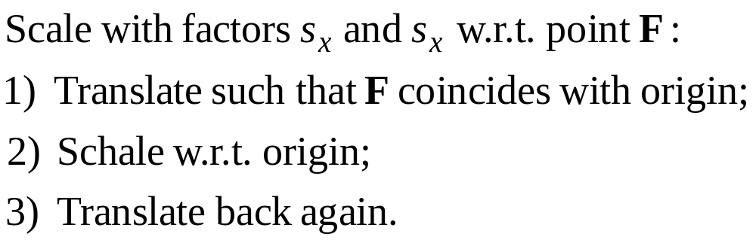
Scaling w.r.t. point 1
F
1) 2) 3)

Slide 43
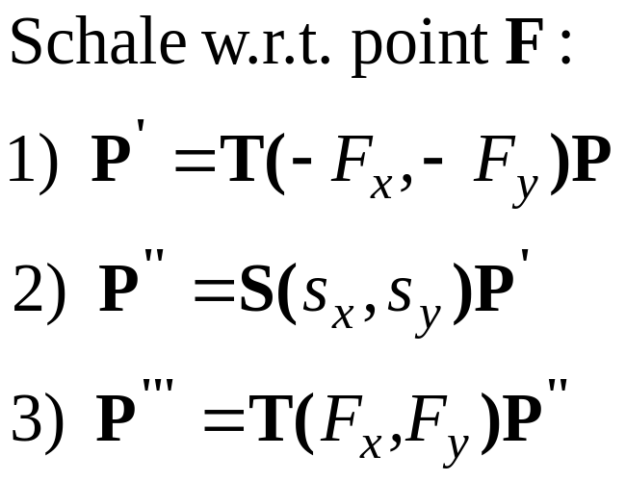
Scaling w.r.t.point 2
F
1) 2) 3)

Slide 44
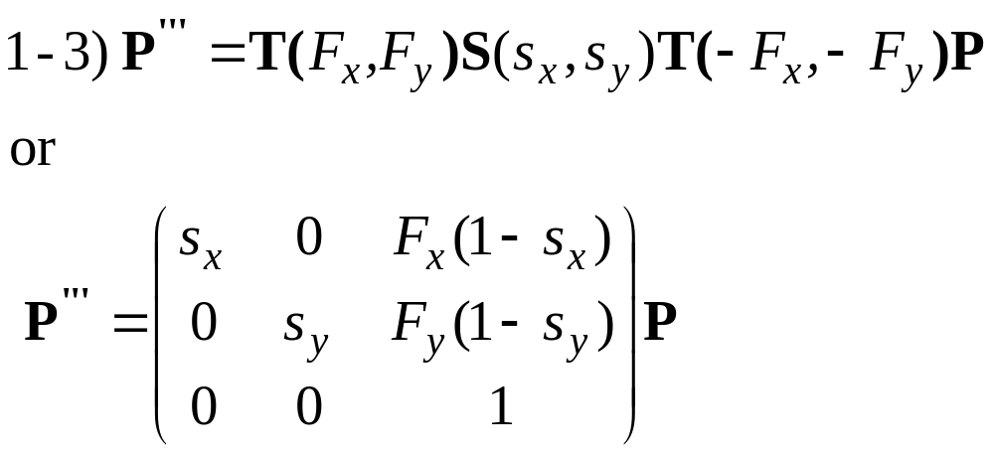
Scaling w.r.t.point 3
F
1) 2) 3)

Slide 45
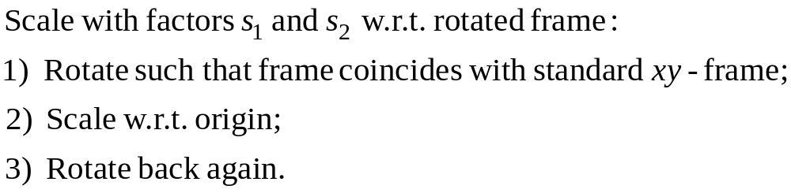
Scale in other directions 1
1) 2) 3)

Slide 46
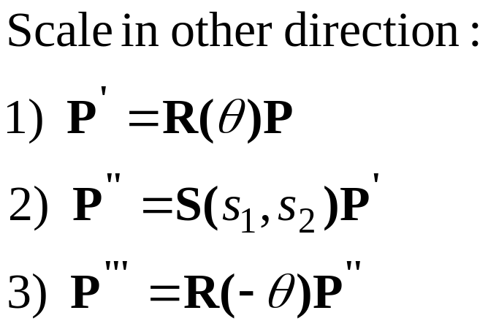
Scale in other directions 2
1) 2) 3)

Slide 47
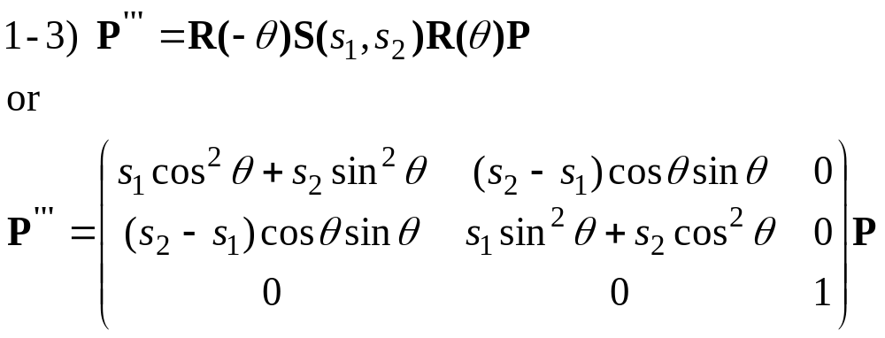
Scale in other directions 3
1) 2) 3)

Slide 48
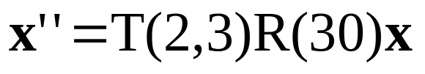
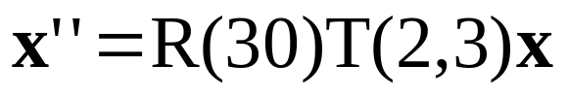
Order of transformations 1
Rotation, translation… Translation, rotation…
y’
y’’
y’’
x’’
x’’
y
y
y’
x’
x’
x
x
Matrix multiplication does not commute.
The order of transformations makes a difference!

Slide 49
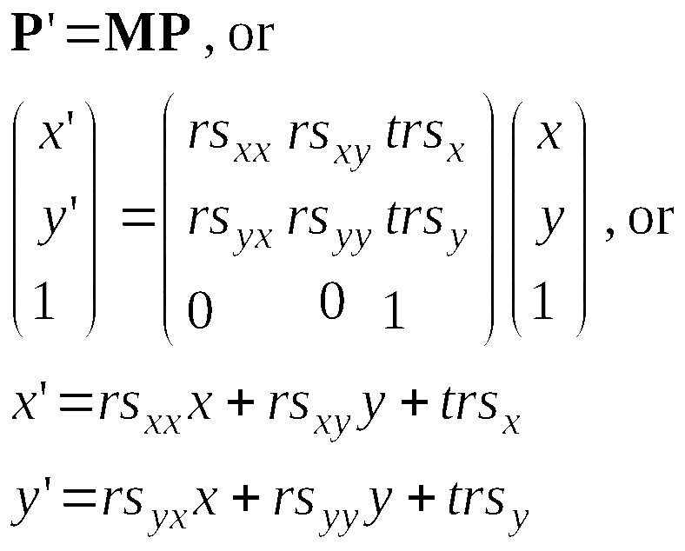
Matrices in general
rotation and scaling
translation

Slide 50
Direct construction of matrix
If you know the target frame:
Construct matrix directly.
Define shape in nice local
u,v coordinates, use matrix
transformation to put it
in x,y space.
y
v
u
B
A
T
x

Slide 51
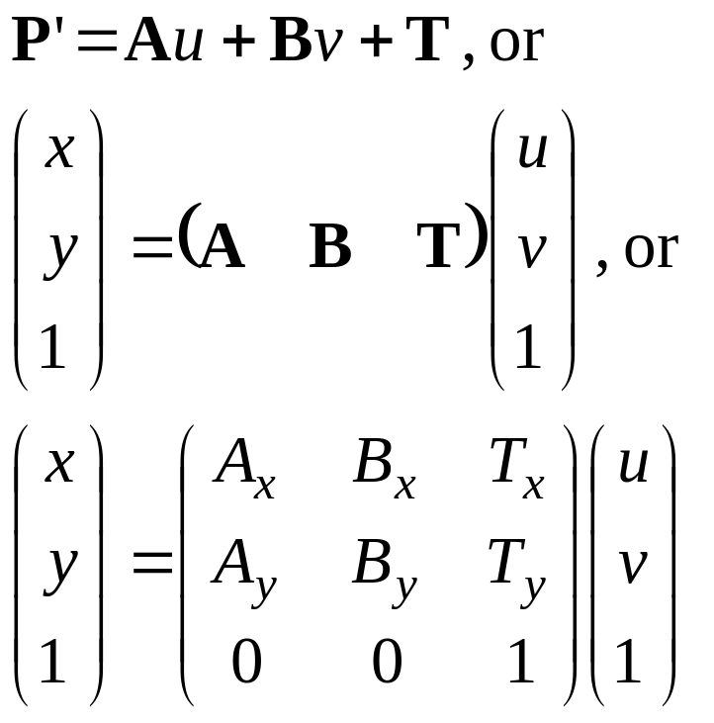
Direct construction of matrix
If you know the target frame:
Construct matrix directly.
y
v
u
B
A
T
x

Slide 52
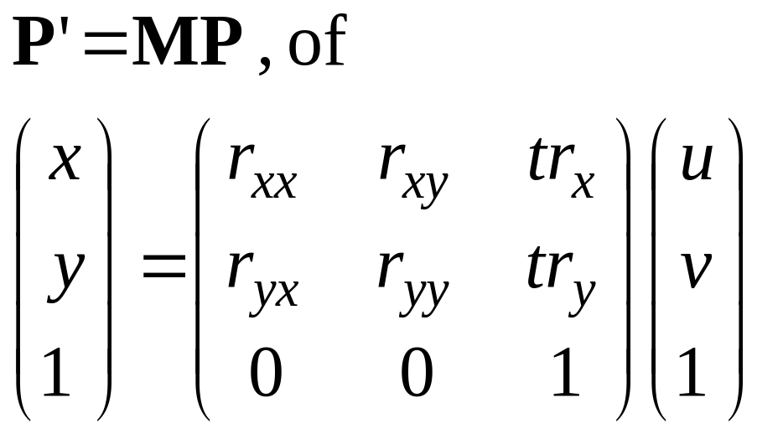
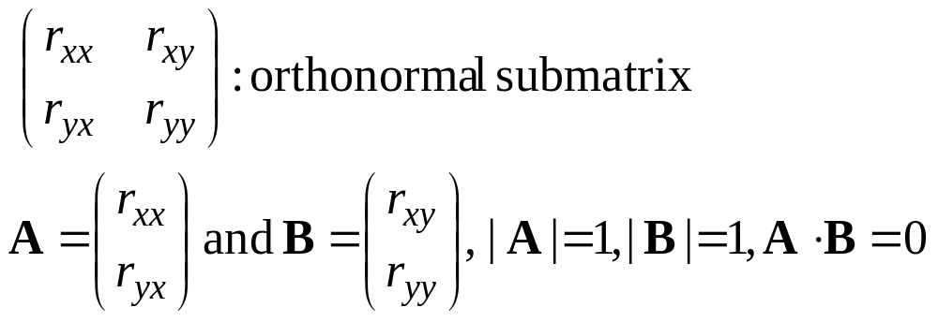
Rigid body transformation
only rotation
translation
y
u
v
B
A
T
x

Slide 53
Other 2D transformations
Reflection
Shear
Can also be combined

Slide 54
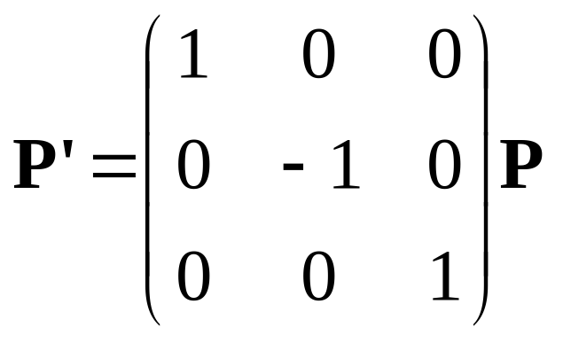
Reflection over axis
Reflext over x-axis:
x’= x, y’= −y
or
y
x

Slide 55
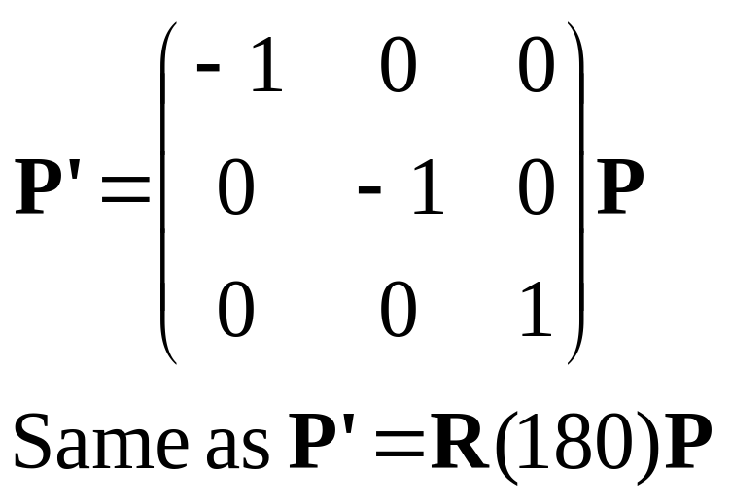
Reflect over origin
Reflect over origin:
x’= −x, y’= − y
or
y
x

Slide 56
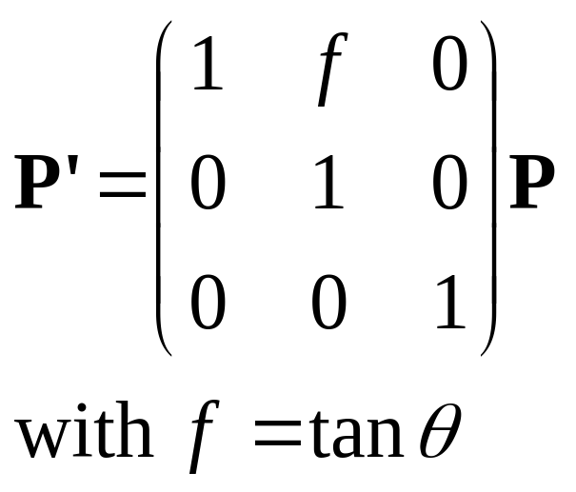
Shear
Shear the y-as:
x’=x+fy, y’=y
or
y
θ
x

Slide 57
Transformations coordinates
Given (x,y)-coordinates,
Find (x’,y’)-coordinates.
Reverse route as
object transformaties.
y
y’
θ
x’
(x₀, y₀)
x

Slide 58
Transformations coordinates
Given (x,y)-coordinates,
Find (x’,y’)-coordinates.
Example: user points at
(x,y), what’s the position
in local coordinates?
y
y’
θ
x’
(x₀, y₀)
x

Slide 59
Transformations coordinates
Given X: (x,y)-coordinates,
Find X’: (x’,y’)-coordinates.
Standard:
X=MX’ (object trafo:
from local to global)
Here:
X’=M⁻¹X (from global to local)
y
y’
θ
x’
(x₀, y₀)
x

Slide 60
Transformations coordinates
Given X: (x,y)-coordinates,
Find X’: (x’,y’)-coordinates.
Here:
X’=M⁻¹X (from global to local)
Approach 1:
- Determine “standard matrix” M (from local to global coordinates) and invert
y
y’
θ
x’
(x₀, y₀)
x

Slide 61
Transformations coordinates
Given X: (x,y)-coordinates,
Find X’: (x’,y’)-coordinates.
Here:
X’=M⁻¹X (from global to local)
Approach 2:
construct transformation that maps local frame to global (reverse of usual).
y
y’
θ
x’
(x₀, y₀)
x

Slide 62
Transformations coordinates
Given X: (x,y)-coordinates,
Find X’: (x’,y’)-coordinates.
Here:
X’=M⁻¹X (from global to local)
Approach 2:
Translate (x₀, y₀) to origin;
Rotate x’-axis to x-axis.
y
y’
θ
x’
(x₀, y₀)
x

Slide 63
Transformations coordinates
Given X: (x,y)-coordinates,
Find X’: (x’,y’)-coordinates.
Here:
X’=M⁻¹X (from global to local)
Approach 2:
M⁻¹ = R(−θ)T(−x₀, −y₀)
y
y’
θ
x’
(x₀, y₀)
x

Slide 64
Thank You

